Slide 1
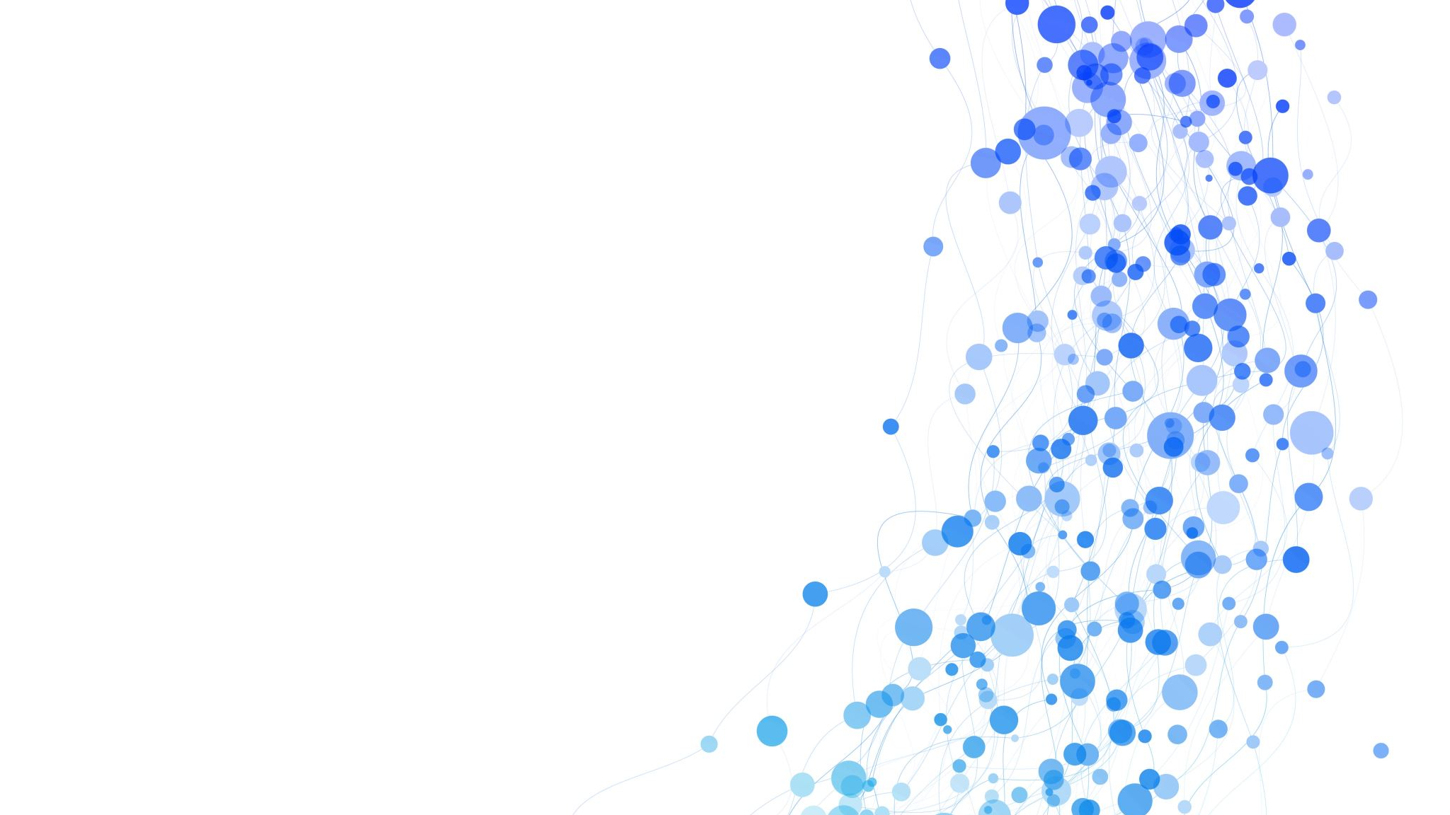
Healthcare Cost Predictor
Josiah Nissley
October 25, 2024

Slide 2
Problem Statement & Context
The problem: High healthcare costs in the U.S.
Context: CDC’s $3.8 trillion expenditure estimation
Success Metrics: Accurate healthcare cost prediction
Stakeholders: Individuals, health insurance providers, government programs
Constraints: Data limitations

Slide 3
Data Science Problem Formulation
Objective: Predict healthcare expenses
Dataset: Sourced from Kaggle, including features like age, sex, BMI, children, smoking status, region, and charges

Slide 4
Data Wrangling
Steps taken: Cleaning data, checking for null values, one hot encoding, standard scaling
Key takeaways: Clean dataset ready for EDA and modeling

Slide 5
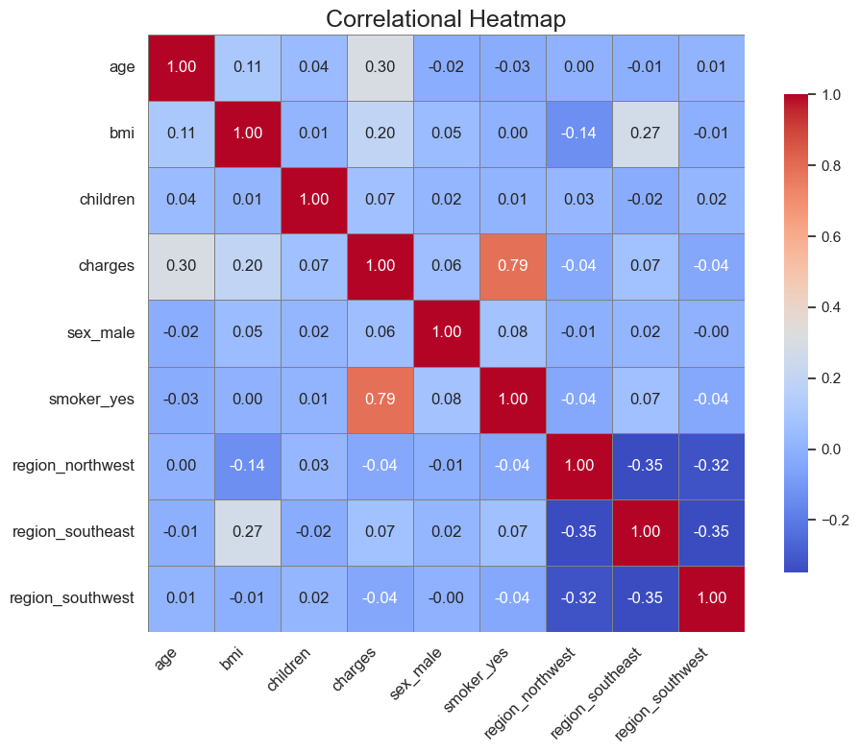
Exploratory Data Analysis

Slide 6
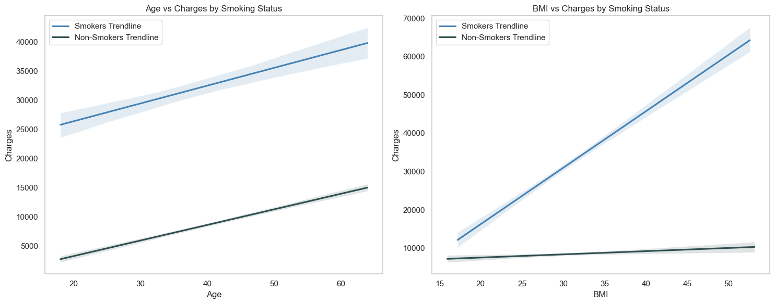

Slide 7
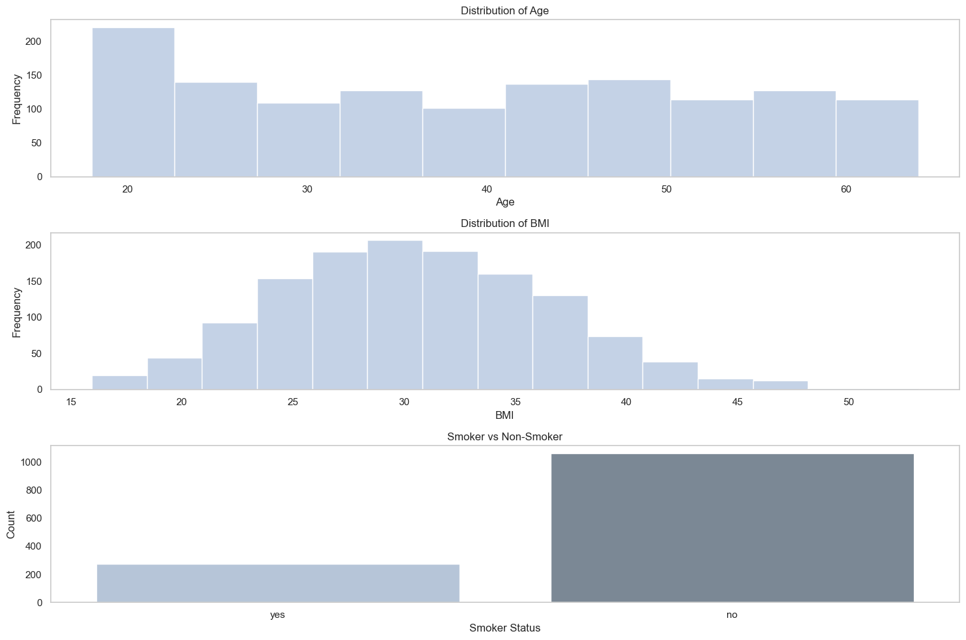

Slide 8
Modeling Selection & Baseline Performance
Baseline Model: Random Forest Regressor
Details: 80/20 split, 100 estimators
Performance: MAE of $2,934.18, R-squared of 0.80
Neural Networks: Three architectures tested with different node structures
Common Setup: Four dense layers, ReLU activation, Adam optimizer, MSE loss function, early stopping

Slide 9
Neural Network Performance
Neural Network Architectures:
First NN: 64, 32, 16 nodes
Second NN: 100, 50, 25 nodes
Third NN: 50, 100, 50 nodes (Best Performance)
Performance: MAE of $3,055.17, R-squared of 0.79

Slide 10
Best Model
Hyperparameter Tuning:
Tool: Hyperband tuner from Keras
Optimal Parameters: 72, 120, 40 nodes, learning rate of 0.001
Improved Performance: MAE of $2,808.88, R-squared of 0.79

Slide 11
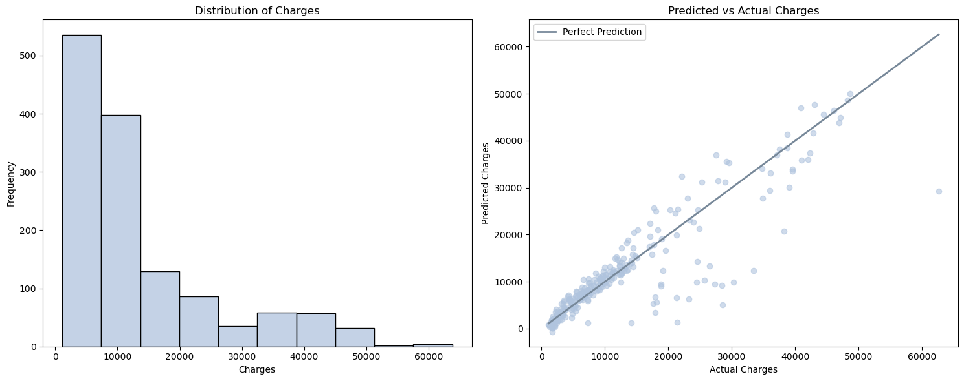
Insights

Slide 12
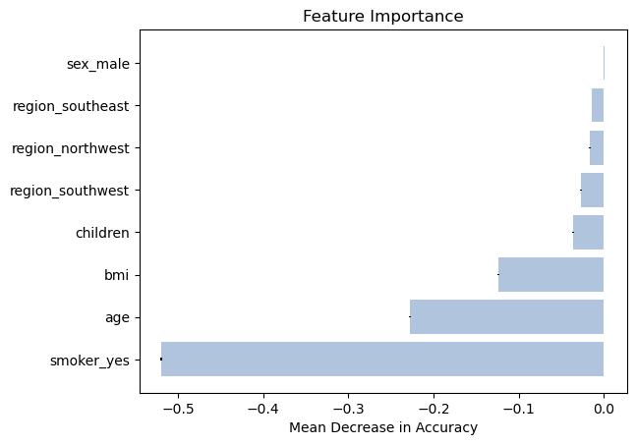
Feature Importance

Slide 13
Recommendations & Future Work
Improvements: Increase dataset size, explore alternative models like XGBoost
Applications: Use as demo/template for future model building

